Slide 1
The Costs of Production
© 2015 Cengage Learning. All Rights Reserved. May not be copied, scanned, or duplicated, in whole or in part, except for use as permitted in a license distributed with a certain product or service or otherwise on a password-protected website for classroom use.

Slide 2
What are Costs?
Industrial organization
  The study of how firms’ decisions about prices and quantities depend on the market conditions they face
Assumption
  The goal of a firm is to maximize profit
Profit
  Total revenue minus total cost
© 2015 Cengage Learning. All Rights Reserved. May not be copied, scanned, or duplicated, in whole or in part, except for use as permitted in a license distributed with a certain product or service or otherwise on a password-protected website for classroom use.

Slide 3
What are Costs?
Total revenue, TR = P × Q
  Amount a firm receives for the sale of its output
  Quantity of output the firm produces times the price at which it sells its output
Total cost, TC
  Market value of the inputs a firm uses in production
© 2015 Cengage Learning. All Rights Reserved. May not be copied, scanned, or duplicated, in whole or in part, except for use as permitted in a license distributed with a certain product or service or otherwise on a password-protected website for classroom use.

Slide 4
What are Costs?
Costs as opportunity costs
  The cost of something is what you give up to get it
Firm’s cost of production
  Include all the opportunity costs of making its output of goods and services
  Explicit costs
  Implicit costs
© 2015 Cengage Learning. All Rights Reserved. May not be copied, scanned, or duplicated, in whole or in part, except for use as permitted in a license distributed with a certain product or service or otherwise on a password-protected website for classroom use.

Slide 5
What are Costs?
Explicit costs
  Input costs that require an outlay of money by the firm
Implicit costs
  Input costs that do not require an outlay of money by the firm
  Ignored by accountants
Total costs
  = Explicit costs + Implicit costs
© 2015 Cengage Learning. All Rights Reserved. May not be copied, scanned, or duplicated, in whole or in part, except for use as permitted in a license distributed with a certain product or service or otherwise on a password-protected website for classroom use.

Slide 6
What are Costs?
The cost of financial capital as an opportunity cost
  Implicit cost
  Interest income not earned on financial capital
    Owned as saving
    Invested in business
  Not shown as cost by an accountant
© 2015 Cengage Learning. All Rights Reserved. May not be copied, scanned, or duplicated, in whole or in part, except for use as permitted in a license distributed with a certain product or service or otherwise on a password-protected website for classroom use.

Slide 7
What are Costs?
Economic profit
  Total revenue minus total cost
    Total costs includes both explicit and implicit costs
Accounting profit
  Total revenue minus total explicit cost
  Usually larger than economic profit
© 2015 Cengage Learning. All Rights Reserved. May not be copied, scanned, or duplicated, in whole or in part, except for use as permitted in a license distributed with a certain product or service or otherwise on a password-protected website for classroom use.

Slide 8
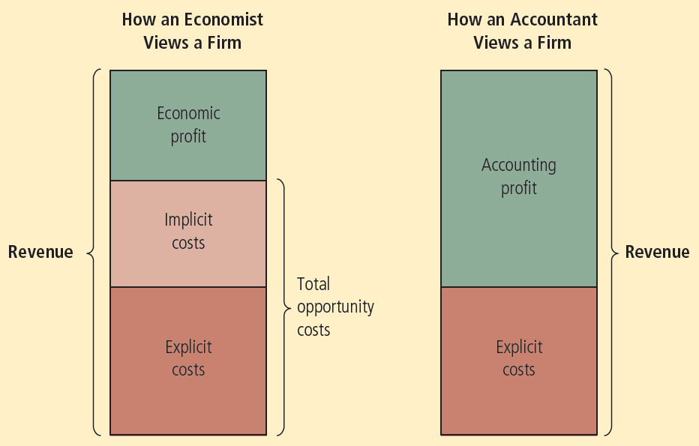
Figure 1
Economists versus Accountants
Economists include all opportunity costs when analyzing a firm, whereas accountants measure only explicit costs. Therefore, economic profit is smaller than accounting profit.
© 2015 Cengage Learning. All Rights Reserved. May not be copied, scanned, or duplicated, in whole or in part, except for use as permitted in a license distributed with a certain product or service or otherwise on a password-protected website for classroom use.

Slide 9
Production and Costs
Production function
  Relationship between
    Quantity of inputs used to make a good
    And the quantity of output of that good
  Gets flatter as production rises
Marginal product
  Increase in output that arises from an additional unit of input
  Slope of the production function
© 2015 Cengage Learning. All Rights Reserved. May not be copied, scanned, or duplicated, in whole or in part, except for use as permitted in a license distributed with a certain product or service or otherwise on a password-protected website for classroom use.

Slide 10
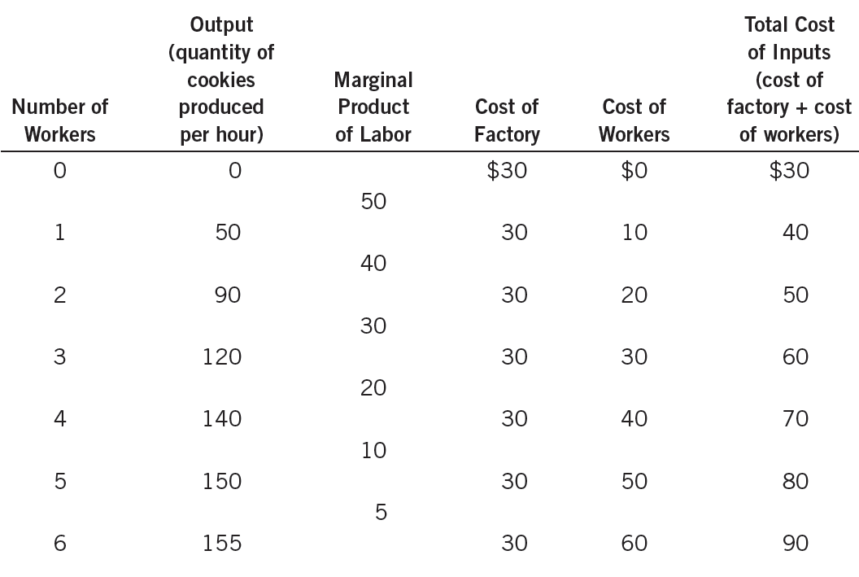
Table 1
A Production Function and Total Cost: Caroline’s Cookie Factory
© 2015 Cengage Learning. All Rights Reserved. May not be copied, scanned, or duplicated, in whole or in part, except for use as permitted in a license distributed with a certain product or service or otherwise on a password-protected website for classroom use.

Slide 11
Production and Costs
Diminishing marginal product
  Marginal product of an input declines as the quantity of the input increases
  Production function gets flatter as more inputs are being used
  The slope of the production function decreases
© 2015 Cengage Learning. All Rights Reserved. May not be copied, scanned, or duplicated, in whole or in part, except for use as permitted in a license distributed with a certain product or service or otherwise on a password-protected website for classroom use.

Slide 12
Production and Costs
Total-cost curve
  Relationship between quantity produced and total costs
  Gets steeper as the amount produced rises
    Diminishing marginal product
    Producing one additional unit of output requires a lot of additional units of inputs
      Very costly
© 2015 Cengage Learning. All Rights Reserved. May not be copied, scanned, or duplicated, in whole or in part, except for use as permitted in a license distributed with a certain product or service or otherwise on a password-protected website for classroom use.

Slide 13
Figure 2
Caroline’s Production Function and Total-Cost Curve
Quantity
of Output
(cookies
per hour)
(a) Production function
Total
Cost
(b) Total-cost curve
Production
function
$90
160
80
Total-cost curve
140
70
120
60
100
50
80
40
60
30
40
20
20
10
0
1
2
3
4
5
6
Number of
Workers Hired
Quantity
of Output
0
20
40
60
80
100
120
140
160
The production function in panel (a) shows the relationship between the number of workers hired and the quantity of output produced. Here the number of workers hired (on the horizontal axis) is from the first column in Table 1, and the quantity of output produced (on the vertical axis) is from the second column. The production function gets flatter as the number of workers increases, reflecting diminishing marginal product. The total-cost curve in panel (b) shows the relationship between the quantity of output produced and total cost of production. Here the quantity of output produced (on the horizontal axis) is from the second column in Table 1, and the total cost (on the vertical axis) is from the sixth column. The total-cost curve gets steeper as the quantity of output increases because of diminishing marginal product.
© 2015 Cengage Learning. All Rights Reserved. May not be copied, scanned, or duplicated, in whole or in part, except for use as permitted in a license distributed with a certain product or service or otherwise on a password-protected website for classroom use.

Slide 14
The Various Measures of Cost
Fixed costs
  Costs that do not vary with the quantity of output produced
Variable costs
  Costs that vary with the quantity of output produced
Total cost
  = Fixed cost + Variable cost
© 2015 Cengage Learning. All Rights Reserved. May not be copied, scanned, or duplicated, in whole or in part, except for use as permitted in a license distributed with a certain product or service or otherwise on a password-protected website for classroom use.

Slide 15
The Various Measures of Cost
Average fixed cost, AFC
  Fixed cost divided by the quantity of output
Average variable cost, AVC
  Variable cost divided by the quantity of output
© 2015 Cengage Learning. All Rights Reserved. May not be copied, scanned, or duplicated, in whole or in part, except for use as permitted in a license distributed with a certain product or service or otherwise on a password-protected website for classroom use.

Slide 16
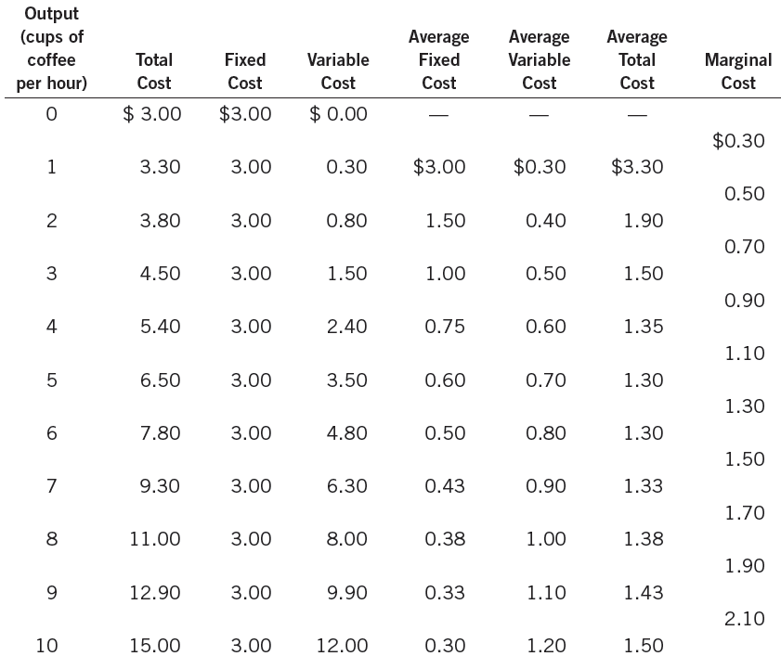
Table 2
The Various Measures of Cost: Conrad’s Coffee Shop
© 2015 Cengage Learning. All Rights Reserved. May not be copied, scanned, or duplicated, in whole or in part, except for use as permitted in a license distributed with a certain product or service or otherwise on a password-protected website for classroom use.

Slide 17
Figure 3
Conrad’s Total-Cost Curve
Total Cost
Here the quantity of output produced (on the horizontal axis) is from the first column in Table 2, and the total cost (on the vertical axis) is from the second column. As in Figure 2, the total-cost curve gets steeper as the quantity of output increases because of diminishing marginal product.
$15.00
14.00
Total-cost curve
13.00
12.00
11.00
10.00
9.00
8.00
7.00
6.00
5.00
4.00
3.00
2.00
1.00
0
1
2
3
4
5
6
7
8
9
10
Quantity of Output
(cups of coffee per hour)
© 2015 Cengage Learning. All Rights Reserved. May not be copied, scanned, or duplicated, in whole or in part, except for use as permitted in a license distributed with a certain product or service or otherwise on a password-protected website for classroom use.

Slide 18
The Various Measures of Cost
Average total cost, ATC
  Total cost divided by the quantity of output
  Average total cost = Total cost / Quantity
  ATC = TC / Q
  Cost of a typical unit of output
    If total cost is divided evenly over all the units produced
© 2015 Cengage Learning. All Rights Reserved. May not be copied, scanned, or duplicated, in whole or in part, except for use as permitted in a license distributed with a certain product or service or otherwise on a password-protected website for classroom use.

Slide 19
The Various Measures of Cost
Marginal cost, MC
  Increase in total cost arising from an extra unit of production
  Marginal cost = Change in total cost / Change in quantity
  MC = ΔTC / ΔQ
  Increase in total cost
    From producing an additional unit of output
© 2015 Cengage Learning. All Rights Reserved. May not be copied, scanned, or duplicated, in whole or in part, except for use as permitted in a license distributed with a certain product or service or otherwise on a password-protected website for classroom use.

Slide 20
The Various Measures of Cost
Rising marginal cost curve
  Because of diminishing marginal product
U-shaped average total cost curve
  ATC = AVC + AFC
  AFC – always declines as output rises
  AVC – typically rises as output increases
    Because of diminishing marginal product
  The bottom of the U-shape
    At quantity that minimizes average total cost
© 2015 Cengage Learning. All Rights Reserved. May not be copied, scanned, or duplicated, in whole or in part, except for use as permitted in a license distributed with a certain product or service or otherwise on a password-protected website for classroom use.

Slide 21
The Various Measures of Cost
Efficient scale
  Quantity of output that minimizes ATC
Relationship between MC and ATC
  When MC < ATC: average total cost is falling
  When MC > ATC: average total cost is rising
  The marginal-cost curve crosses the average-total-cost curve at its minimum
© 2015 Cengage Learning. All Rights Reserved. May not be copied, scanned, or duplicated, in whole or in part, except for use as permitted in a license distributed with a certain product or service or otherwise on a password-protected website for classroom use.

Slide 22
Figure 4
Conrad’s Average-Cost and Marginal-Cost Curves
Costs
This figure shows the average total cost (ATC), average fixed cost (AFC), average variable cost (AVC), and marginal cost (MC) for Conrad’s Coffee Shop. All of these curves are obtained by graphing the data in Table 2. These cost curves show three features that are typical of many firms: (1) Marginal cost rises with the quantity of output. (2) The average-total-cost curve is U-shaped. (3) The marginal-cost curve crosses the average-total-cost curve at the minimum of average total cost.
$3.50
3.25
3.00
2.75
2.50
MC
2.25
2.00
1.75
ATC
1.50
1.25
AVC
1.00
0.75
0.50
AFC
0.25
0
1
2
3
4
5
6
7
8
9
10
Quantity of Output (cups of coffee per hour)
© 2015 Cengage Learning. All Rights Reserved. May not be copied, scanned, or duplicated, in whole or in part, except for use as permitted in a license distributed with a certain product or service or otherwise on a password-protected website for classroom use.

Slide 23
The Various Measures of Cost
Typical cost curves
  Marginal cost eventually rises with the quantity of output
  Average-total-cost curve is U-shaped
  Marginal-cost curve crosses the average-total-cost curve at the minimum of average total cost
© 2015 Cengage Learning. All Rights Reserved. May not be copied, scanned, or duplicated, in whole or in part, except for use as permitted in a license distributed with a certain product or service or otherwise on a password-protected website for classroom use.

Slide 24
Figure 5
Cost Curves for a Typical Firm
Costs
Many firms experience increasing marginal product before diminishing marginal product. As a result, they have cost curves shaped like those in this figure. Notice that marginal cost and average variable cost fall for a while before starting to rise.
$3.00
2.50
MC
2.00
1.50
ATC
1.00
AVC
0.50
AFC
0
2
4
6
8
10
12
14
Quantity of Output
© 2015 Cengage Learning. All Rights Reserved. May not be copied, scanned, or duplicated, in whole or in part, except for use as permitted in a license distributed with a certain product or service or otherwise on a password-protected website for classroom use.

Slide 25
Costs in Short and Long Run
Many decisions
  Fixed in the short run
  Variable in the long run
Firms – greater flexibility in the long-run
  Long-run cost curves
    Differ from short-run cost curves
    Much flatter than short-run cost curves
  Short-run cost curves
    Lie on or above the long-run cost curves
© 2015 Cengage Learning. All Rights Reserved. May not be copied, scanned, or duplicated, in whole or in part, except for use as permitted in a license distributed with a certain product or service or otherwise on a password-protected website for classroom use.

Slide 26
Figure 6
Average Total Cost in the Short and Long Runs
Average
Total
Cost
ATC in short run
with medium factory
ATC in short run
with small factory
ATC in short run
with large factory
ATC in long run
$12,000
10,000
Economies
of scale
Diseconomies
of scale
Constant returns to scale
0
1,000
1,200
Quantity of Cars per Day
Because fixed costs are variable in the long run, the average-total-cost curve in the short run differs from the average-total-cost curve in the long run.
© 2015 Cengage Learning. All Rights Reserved. May not be copied, scanned, or duplicated, in whole or in part, except for use as permitted in a license distributed with a certain product or service or otherwise on a password-protected website for classroom use.

Slide 27
Costs in Short and Long Run
Economies of scale
  Long-run average total cost falls as the quantity of output increases
  Increasing specialization among workers
Constant returns to scale
  Long-run average total cost stays the same as the quantity of output changes
© 2015 Cengage Learning. All Rights Reserved. May not be copied, scanned, or duplicated, in whole or in part, except for use as permitted in a license distributed with a certain product or service or otherwise on a password-protected website for classroom use.

Slide 28
Costs in Short and Long Run
Diseconomies of scale
  Long-run average total cost rises as the quantity of output increases
  Increasing coordination problems
© 2015 Cengage Learning. All Rights Reserved. May not be copied, scanned, or duplicated, in whole or in part, except for use as permitted in a license distributed with a certain product or service or otherwise on a password-protected website for classroom use.

Slide 29
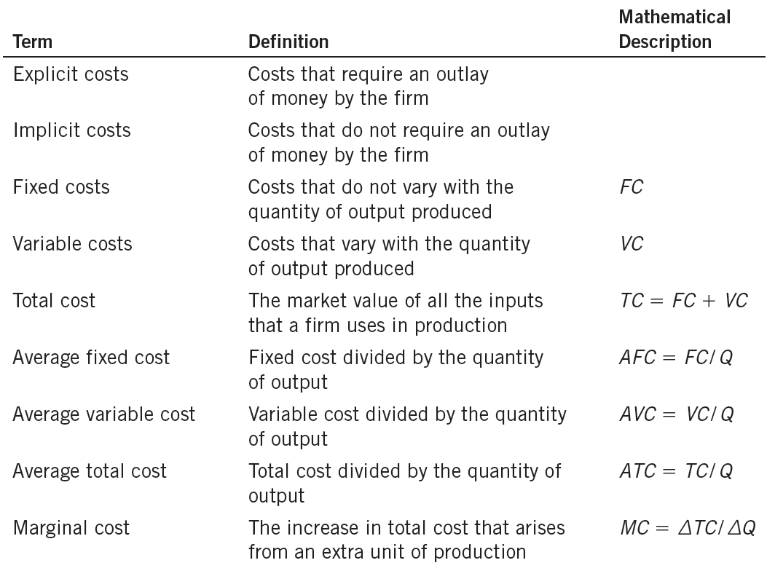
Table 3
The Many Types of Cost: A Summary
© 2015 Cengage Learning. All Rights Reserved. May not be copied, scanned, or duplicated, in whole or in part, except for use as permitted in a license distributed with a certain product or service or otherwise on a password-protected website for classroom use.

